Slide 1

Mental Health Awareness Week
12-18 May 2025
Notes:
Introduce the assembly, explaining that Mind are a mental health charity. Mind’s Mental Health Awareness Week is 12-18 May, 2025.

Slide 2

Mental health is everything, everywhere, everyone.
Notes:
Explain that Mind’s campaign message this is year is ‘mental health is everything, everywhere, everyone.’
Ask students to take a few moments to reflect on this statement and what they think it means.
You may want to invite students to share some of their ideas.

Slide 3


Mental Health Awareness Week
Mental health is part of our everyday lives. It is connected to everything we do, every place we go, and every person around us.
Mental health is how we think, feel and act.
We all have mental health and need to take care of it.
Notes:
Read the slide giving more information about the key message for Mental Health Awareness Week and a definition of mental health.

Slide 4

Mental health
Our mental health can range from good to poor.
Poor mental health can affect anyone at anytime.
We may need help and support at different times in our lives.
Notes:
Read the text on the slide which further develops the definition of mental health. Also say: Remember: we can all experience difficult feelings and poor mental health. If this is happening to you, you are not alone.

Slide 5
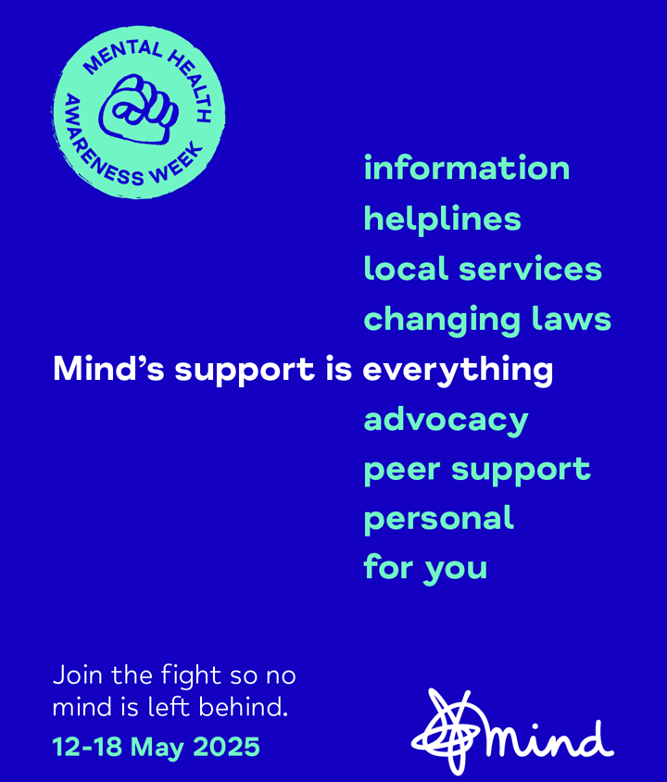
No mind left behind
Mind is a charity who work to make sure everyone can get the help and support they need.
Information and advice for young people aged 11-18.
www.mind.org.uk/for-young-people/
Notes:
Give students more information about the role of the charity.
Mind:
change minds - by making mental health an everyday priority.
support minds - by offering help whenever you might need it through our information, advice and local services.
connect minds - by bringing together people who care about mental health to make a difference.
Highlight that Mind have dedicated webpages for young people with lots of practical information about mental health, getting help for yourself and for others.

Slide 6


Mental health is connected to…
home
money
physical health
news stories
relationships
school
sleep
socialising
Notes:
Going back to the theme of Mind’s Mental Health Awareness Week, recap that mental health is part of our everyday lives - connected to everything we do, every place we go, and every person around us.
Explain that mental health can be linked to everything from our physical health, to our finances, and our relationships.
Our mental health can affect different parts of our lives - for example, if someone is feeling worried, they might not sleep well, or if someone is feeling anxious, they might stop socialising.
Different things happening in our lives, can also affect our mental health - for example, a shocking news story might make someone feel upset, or not having enough money could make someone feel stressed.

Slide 7

Talking about mental health…
Start a conversation with someone you trust…
… if your mental health is affecting something in your life.
… if something in your life is affecting your mental health.
Notes:
Read the slide, explaining that talking to people who care about you, can help you look after your mental health and cope with how you're feeling.

Slide 8

Starting a conversation…
Find a way that feels right for you.
Find a good time.
Practise what you want to say.
Explain how you have been feeling and how it impacts your life.
Suggest how they could help.
Make a plan to take care of yourself after.
Notes:
Acknowledge that opening up about your mental health is not always easy and you might not know where to start, but here are some tips and ideas that could help:
Find a way that feels right for you – in-person, phone, video call, voice-note, email, letter, text, drawing/painting.
Find a good time – there probably won’t be a perfect time, but try to make it when and where you feel comfortable, when you are both free and won’t be interrupted.
Practise what you want to say – either in your head, or write it down, or leave yourself a voice-note. Only share what you feel comfortable to share.
Explain how you have been feeling and how it impacts your life – think about the different areas of your life and explain your feelings as best as you can.
Suggest how they could help – this could be helping you find information, talking to your school, making a doctor's appointment for you or just being there to listen and support you. Also, tell them things that might not help, such as treating you differently, or telling other people how you are feeling.
Make a plan to take care of yourself after – opening up can feel difficult and tiring, so you could think of something nice to do afterwards, like watching your favourite TV show or going for a walk.

Slide 9
When to ask for support
If you are not feeling yourself.
If you have been through or are going through something difficult.
If you are finding it hard to cope with how you feel or with things in everyday life.
If you want someone to know how you've been feeling.
If you want or need help.
Whatever you're going through, you don't need to cope on your own.
Notes:
Read the slide and then say: There's no perfect time to open up. You can open up about how you're feeling at any time – you don't have to wait for it to get worse. The sooner you can open up, the sooner you might start to feel better. And it’s never too late to talk about how you feel. We all deserve support.

Slide 10
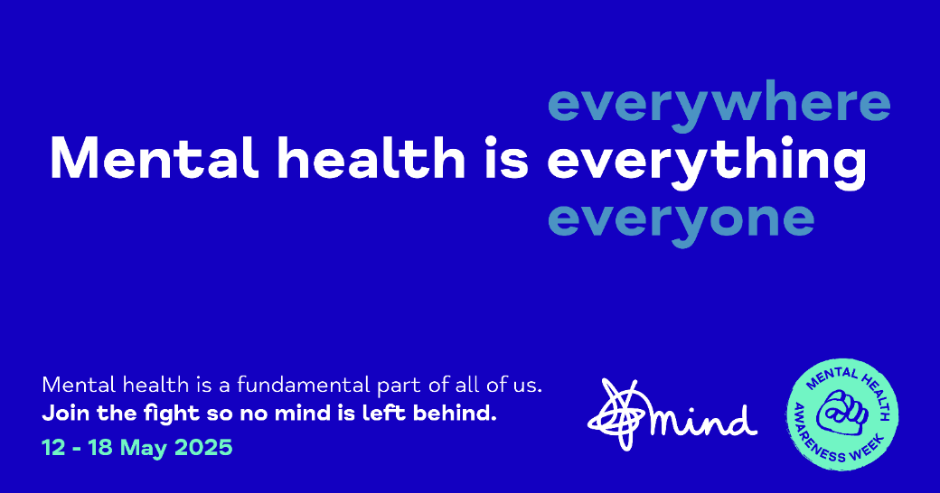
Share…
Notes:
Encourage students to help share Mind’s Mental Health Awareness Week campaign message.

Slide 11
Information for teachers

Slide 12
Mental Health Awareness Week
Assembly – 20 mins
Learning objective:
Learning outcomes:
Students will be able to:
recognise how mental health impacts, and is impacted by, many other areas of life.
recognise how Mind support young people’s mental health.
identify when and how to reach out and open up about their mental health.
To learn how mental health is an integral part of life and how to get support.
This assembly is suitable for students from key stages 3 to 4.

Slide 13
Assembly notes
Slide 1: Introduce the assembly, explaining that Mind are a mental health charity. Mind’s Mental Health Awareness Week is 12-18 May, 2025.
Slide 2: Explain that Mind’s campaign message this is year is ‘mental health is everything, everywhere, everyone.’ Ask students to take a few moments to reflect on this statement and what they think it means. You may want to invite students to share some of their ideas
Slide 3: Read the slide giving more information about the key message for Mental Health Awareness Week and a definition of mental health.
Slide 4: Read the text on the slide which further develops the definition of mental health. Also say: Remember: we can all experience difficult feelings and poor mental health. If this is happening to you, you are not alone.
Slide 5: Give students more information about the role of the charity. Mind change minds - by making mental health an everyday priority. Mind support minds - by offering help whenever you might need it through our information, advice and local services. Mind connect minds - by bringing together people who care about mental health to make a difference. Highlight that Mind have dedicated webpages for young people with lots of practical information about mental health, getting help for yourself and for others.
Slide 6:Going back to the theme of Mind’s Mental Health Awareness Week, recap that mental health is part of our everyday lives - connected to everything we do, every place we go, and every person around us. Explain that mental health can be linked to everything from our physical health, to our finances, and our relationships.
  Our mental health can affect different parts of our lives - for example, if someone is feeling worried, they might not sleep well, or if someone is feeling anxious, they might stop socialising.
  Different things happening in our lives, can also affect our mental health - for example, a shocking news story might make someone feel upset, or not having enough money could make someone feel stressed.

Slide 14
Assembly notes continued…
Slide 7: Read the slide, explaining that talking to people who care about you, can help you look after your mental health and cope with how you're feeling.
Slide 8: Acknowledge that this is not always easy, but here are some tips and ideas that could help:
  Find a way that feels right for you – in-person, phone, video call, voice-note, email, letter, text, drawing/painting.
  Find a good time – there probably won’t be a perfect time, but try to make it when and where you feel comfortable, when you are both free and won’t be interrupted.
  Practise what you want to say – either in your head, or write it down, or leave yourself a voice-note. Only share what you feel comfortable to share.
  Explain how you have been feeling and how it impacts your life – think about the different areas of your life and explain your feelings as best as you can.
  Suggest how they could help – this could be helping you find information, talking to your school, making a doctor's appointment for you or just being there to listen and support you.Also, tell them things that might not help, such as treating you differently, or telling other people how you are feeling.
  Make a plan to take care of yourself after – opening up can feel difficult and tiring, so you could think of something nice to do afterwards, like watching your favourite TV show or going for a walk.

Slide 15
Assembly notes continued…
Slide 9: Read the slide and then say: There's no perfect time to open up. You can open up about how you're feeling at any time – you don't have to wait for it to get worse. The sooner you can open up, the sooner you might start to feel better. And it’s never too late to talk about how you feel. We all deserve support.
Slide 10: Encourage students to help share Mind’s Mental Health Awareness Week campaign message.

Slide 16
Curriculum Links – secondary
This lesson helps to address the following statutory requirements, which can be found in full, here.
Statutory Health Education, Department for Education (DfE)
Mental wellbeing
By the end of secondary school, pupils should know:
how to recognise the early signs of mental wellbeing concerns.
how to critically evaluate when something they do or are involved in has a positive or negative effect on their own or others’ mental health.
Notes:
Reference: https://www.gov.uk/government/publications/relationships-education-relationships-and-sex-education-rse-and-health-education

Slide 17
Curriculum Links – KS3
This lesson helps to address the following learning opportunities from the PSHE Association Programme of Study.
Self-concept Students learn…
H2. to understand what can affect wellbeing and resilience (e.g. life changes, relationships, achievements and employment).
Health and wellbeing Students learn…
H7. the characteristics of mental and emotional health and strategies for managing these
H10. a range of healthy coping strategies and ways to promote wellbeing and boost mood, including… the value of positive relationships in providing support.
H12. how to recognise when they or others need help with their mental health and wellbeing; sources of help and support and strategies for accessing what they need.
Notes:
Reference: https://pshe-association.org.uk/guidance/ks1-5/planning/long-term-planning

Slide 18
Curriculum Links – KS4
This lesson helps to address the following learning opportunities from the PSHE Association Programme of Study.
Self-concept Students learn…
H2. how self-confidence, self-esteem, and mental health are affected positively and negatively by internal and external influences and ways of managing this.
Emotional health and wellbeing Students learn…
H6. about change and its impact on mental health and wellbeing and to recognise the need for emotional support during life changes and/or difficult experiences.
H7. a broad range of strategies — cognitive and practical — for promoting their own emotional wellbeing, for avoiding negative thinking and for ways of managing mental health concerns
H8. to recognise warning signs of common mental and emotional health concerns (including stress, anxiety and depression), what might trigger them and what help or treatment is available.
Healthy lifestyles Students learn…
H14. about the health services available to people; strategies to become a confident user of the NHS and other health services; to overcome potential concerns or barriers to seeking help.
Notes:
Reference: https://pshe-association.org.uk/guidance/ks1-5/planning/long-term-planning

